Slide 1
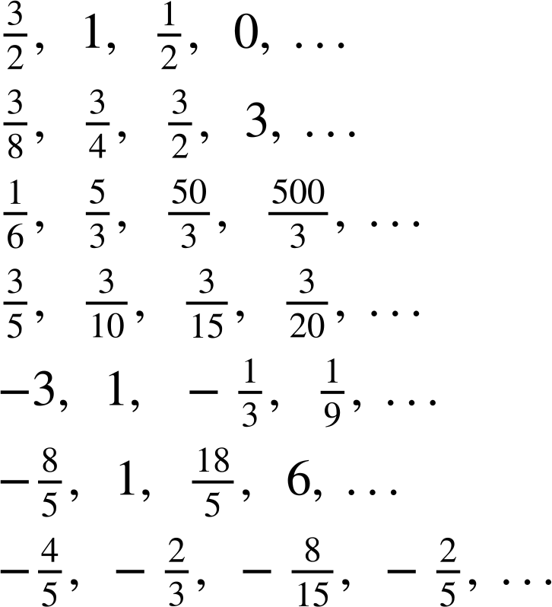
Recognising special number sequences
Task A: Arithmetic and geometric sequences
Sort these sequences into the correct column of the table.
arithmetic | geometric | neither
1, 2, 3, 4, 5, …
3, 9, 27, 81, ….
0.5, 1, 2, 4, …
1, 1, 2, 4, 7, …
1, 2, 4, 7, 11, …
−2, 4, −8, 16, …
−1, 5, 11, 17, 23, …
18, 35, 52, 68, …
36, 12, −12, −36 …
13.5, 9, 6, 4, …
12, 6 , 3 , 0, …
2) Sort these sequences into the correct column of the table.
arithmetic | geometric | neither
a)
b)
c)
d)
e)
f)
g)
3) A sequence starts 2a, 6a, …
a) If the sequence was arithmetic, what would the next three terms be?
b) If the sequence was geometric, what would the next three terms be?
c) Continue this sequence in another way, describe the rule you have used.

Slide 2
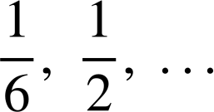
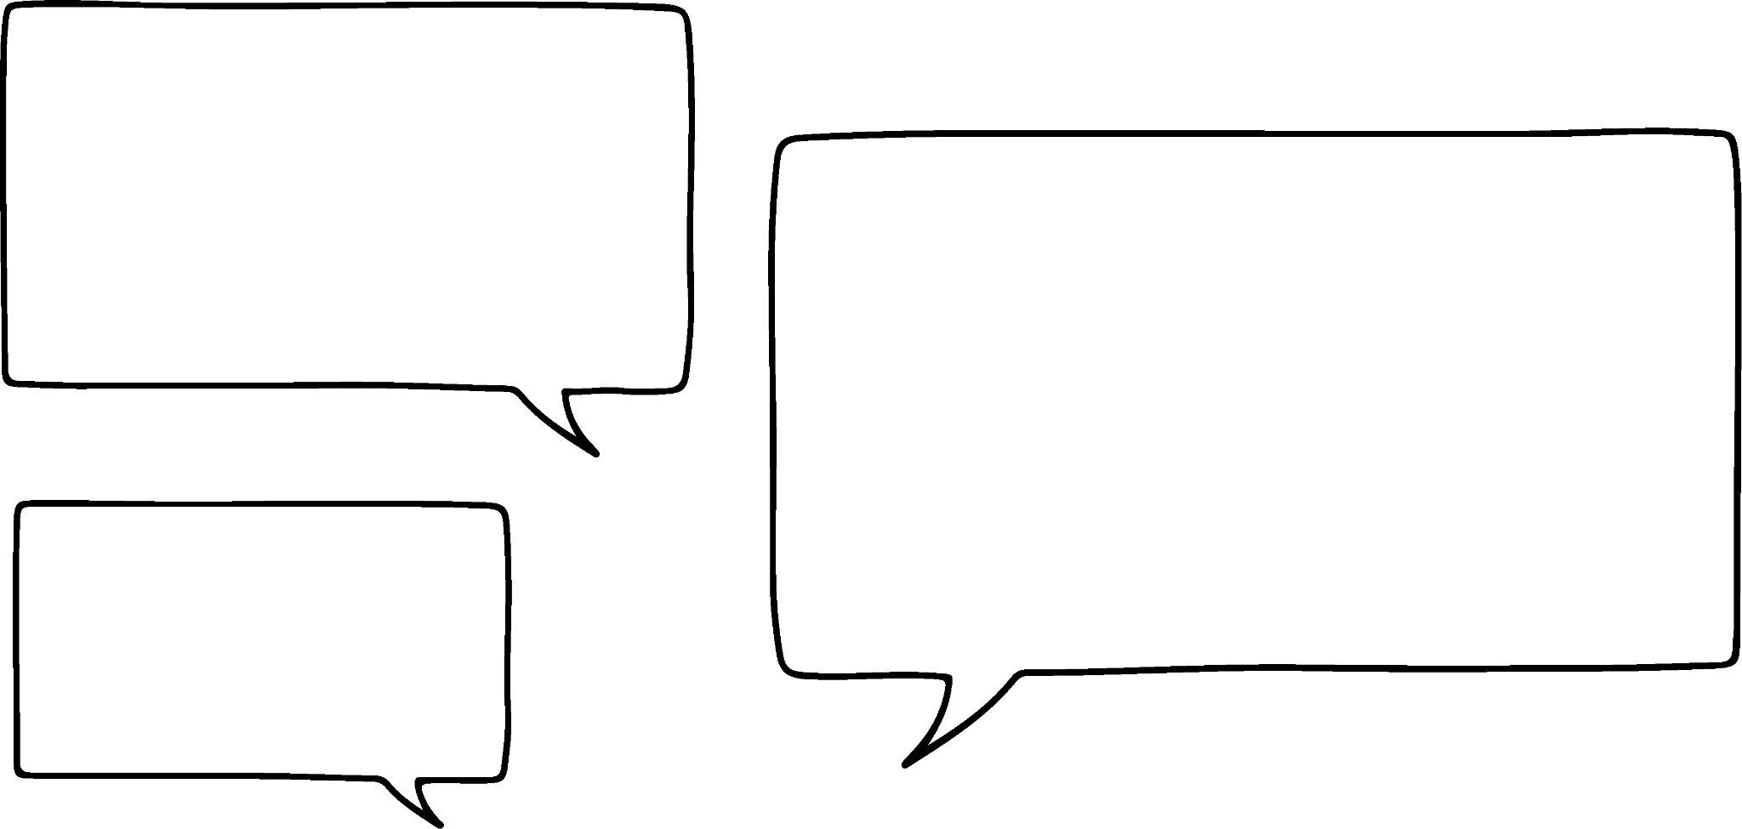
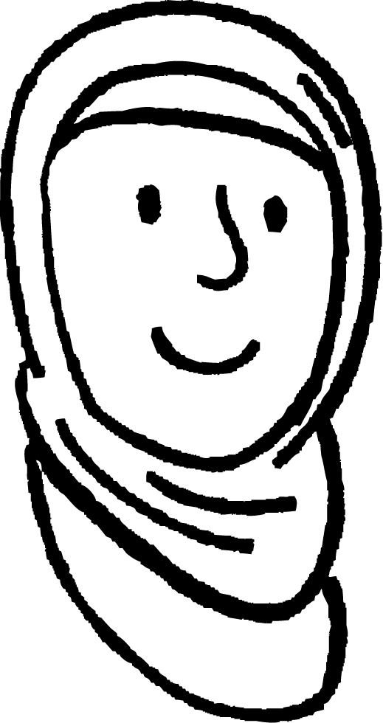
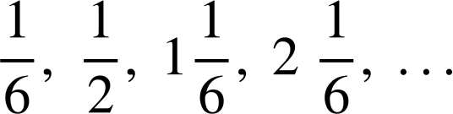
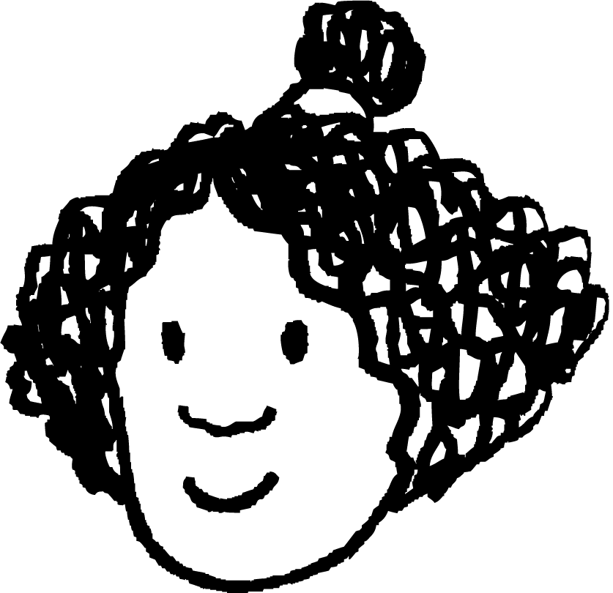
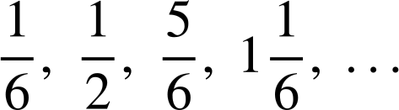
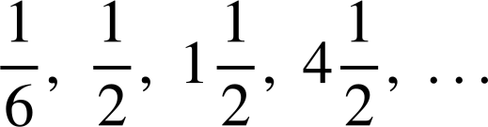

Recognising special number sequences
Task B: Exploring other sequences
1) By working out the pattern, find the next two terms in each sequence.
2, 8, 32, 128, …
2, 8, 14, 20, …
2, 8, 15, 23, …
2, 8, 16, 26, …
2, 8, 10, 18, …
2, 8, 17, 29, …
8, 2, 10, 12, …
8, 2, −4, −10, …
3, 5, 11, 21, …
4, 6, 12, 22, …
6, 10, 22, 42, …
−3, −5, −8, −13, …
−3, −5, −7, −9, …
2, −6, 18, −54, …
1, −7, −10, −8, …
2) Aisha, Izzy and Lucas have all created a sequence starting with the terms
For each question justify your answer.
a) Who has created an arithmetic sequence?
b) Who has created a geometric sequence?
c) Who has created a quadratic sequence?
Aisha
Izzy
Lucas
Mathematics in Education and Industry.
v2.3

